Slide 1
Maistor.bg
Tsvetelin Takiev & Martin Ivanov

Slide 2
Main functionality
Registration and login
Upload a profile picture
Creating a post
Making an offer for a post
Accepting offer from worker
Comment and rate a worker
Add category and delete category(admin)

Slide 3
What we used?
Technologies and API’s
Java 8
Spring Boot
Spring Rest
Spring Data JPA
Maven
Hibernate
JPA
MySQL
BCrypt
Lombok
Model Mapper
Software
InteliJ IDEA
Postman
Git

Slide 4
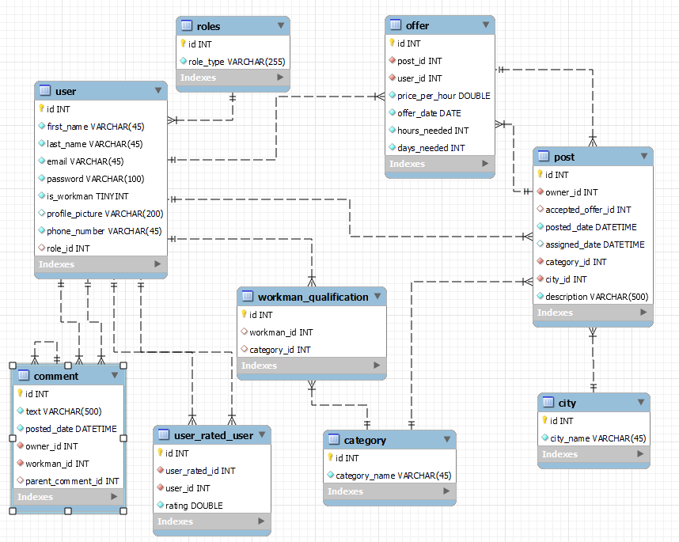
Database

Slide 5
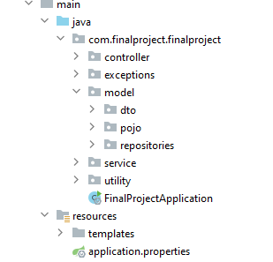
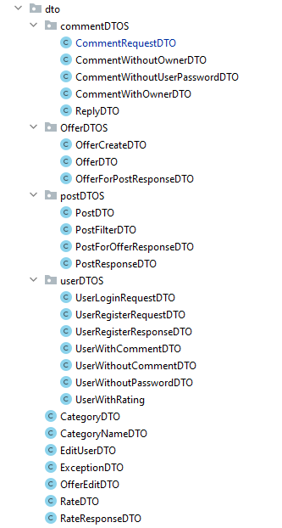
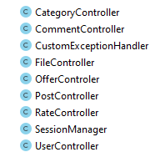
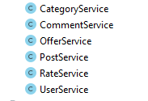
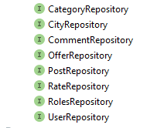
Class structure

Slide 6
Demo
Let’s see how everything works!

Slide 7

Questions?

Slide 8
Thank You !

